Slide 1
Group Project 3
CS 331
Nov. 20. 2019 - Dec. 11. 2019
Group Members
Thomas Jimenez
Mudit Prashar
Dylan Rambarran

Slide 2
Team Contributions
Thomas Jimenez – Database Design
Mudit Prashar – Project Manager, Tracking documents
Dylan Rambarran – Powerpoint, Video

Slide 3
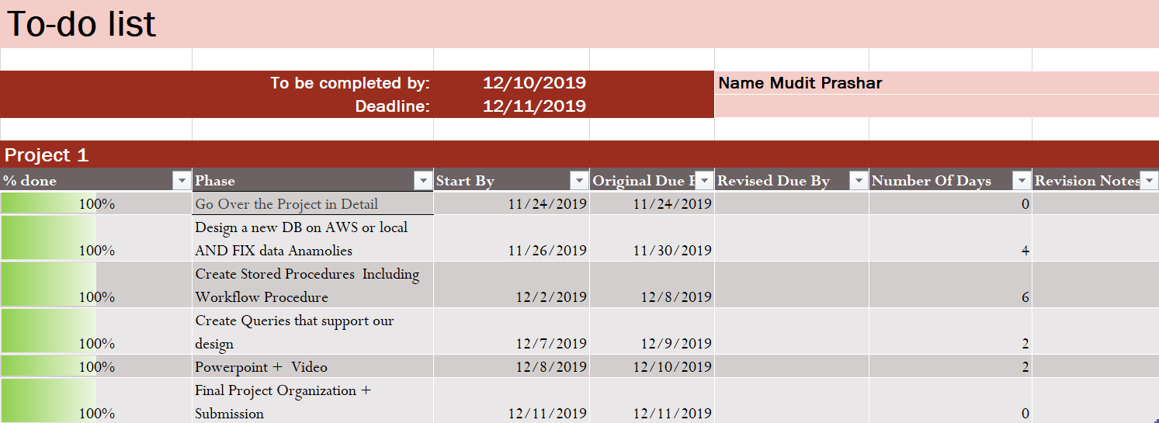
Todo List Documentation
The phases were divided by the following:
The todo list for group members was the same since the project collaborative work in all the parts.
Go Over the Project in Detail
Design a new DB on AWS or local AND FIX data Anamolies
Create Stored Procedures Including Workflow Procedure
Create Queries that support our design
Powerpoint + Video
Final Project Organization + Submission

Slide 4
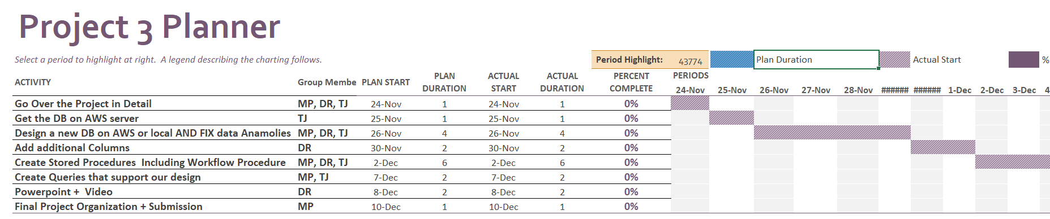
Project Plan Documentation
Project Planner was set after the first meeting.
Each activity serves as task all the member in the team has to do or contribute to.
Project planner helped laying out the structure for the project and break it down in parts.
Plan Date and Plan duration was set in advance.

Slide 5
Notable Team Effort
Thomas: DBM Design, Creating procedures, Files management
Mudit: Overseeing project, Responsible for the Project Planner, Tracking documentation, Creating Procedures
Dylan: Powerpoint, Assembling videos, Creating procedures

Slide 6
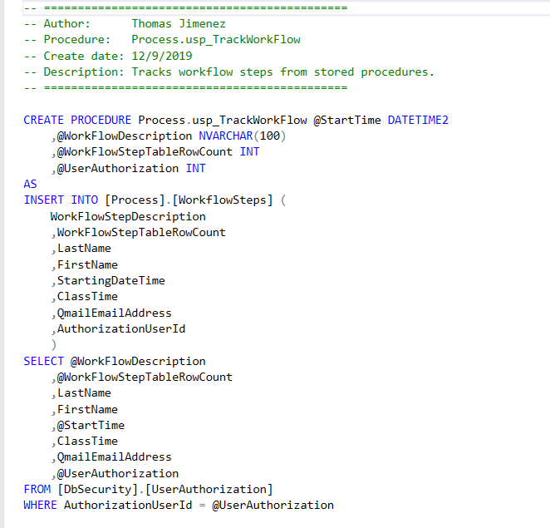
Thomas' Procedures
Process.usp_LoadTrackWorkFlow

Slide 7
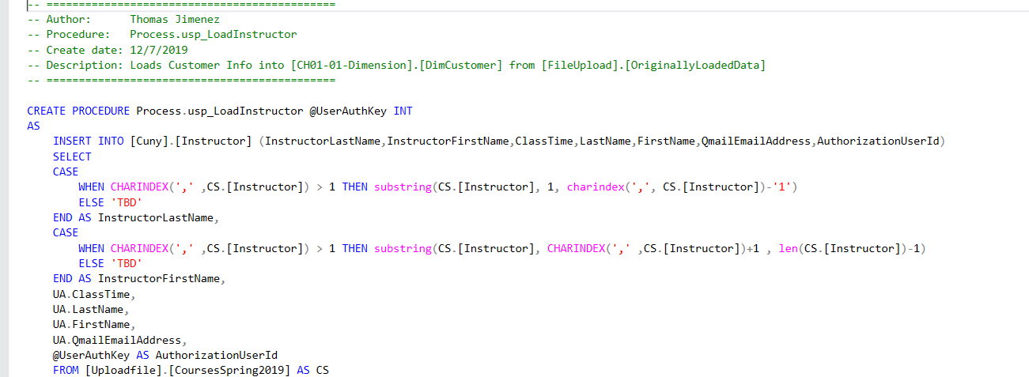
Thomas' Procedures
Process.usp_ LoadInstructor

Slide 8
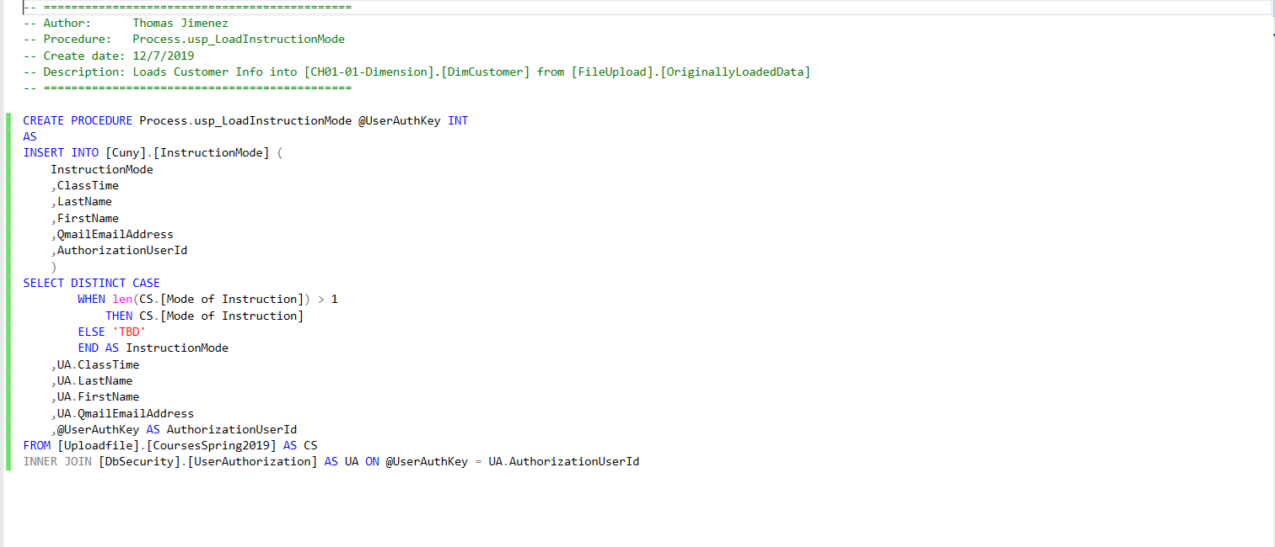
Thomas' Procedures
Process.usp_LoadInstructionMode

Slide 9
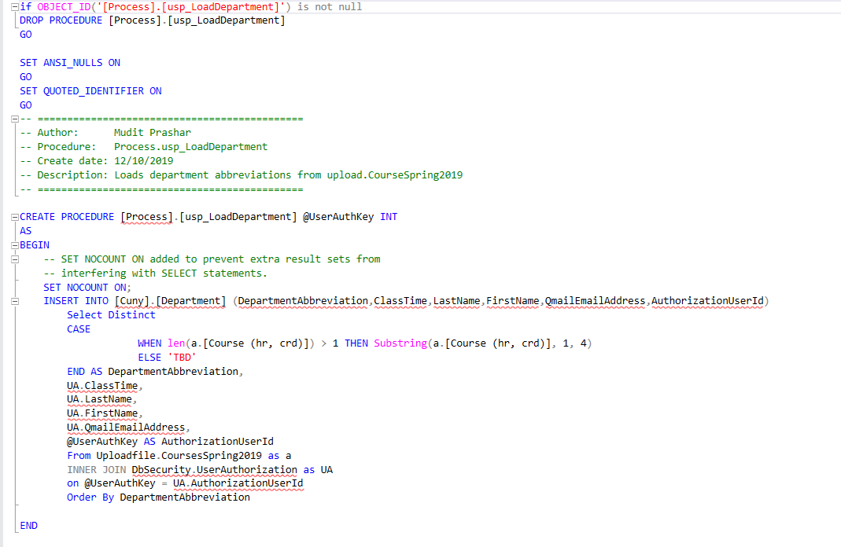
Mudit's Procedures
Process.usp_LoadDepartment

Slide 10
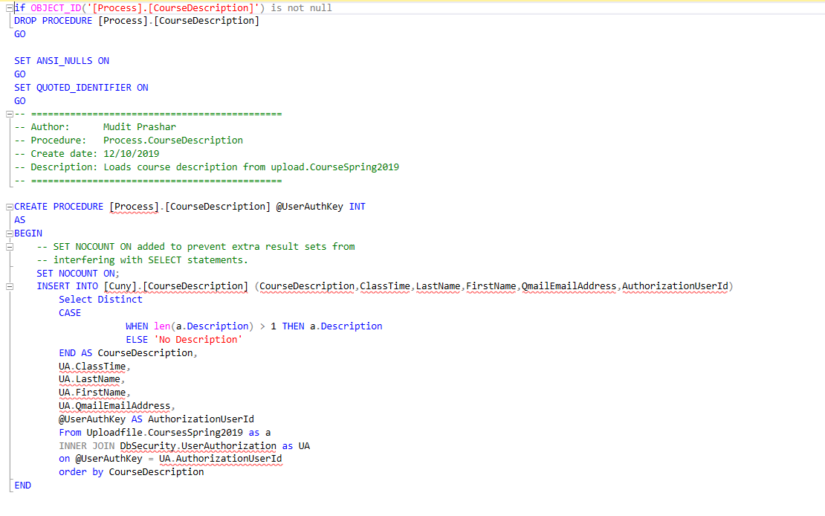
Mudit's Procedures
Process.CourseDescription

Slide 11
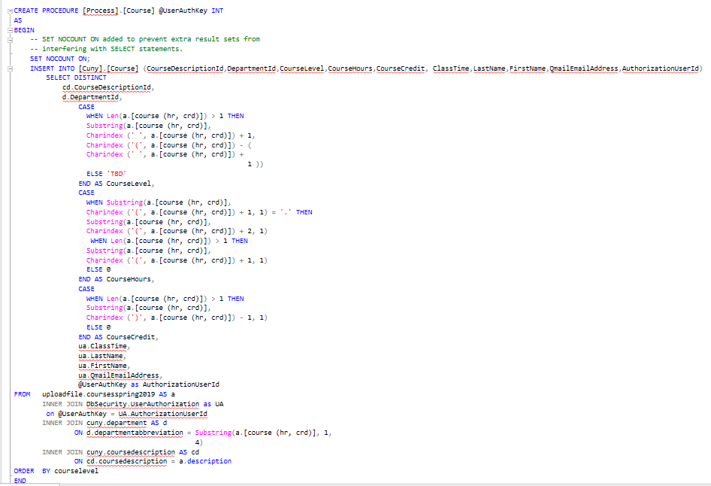
Mudit's Procedures
Process.Course

Slide 12
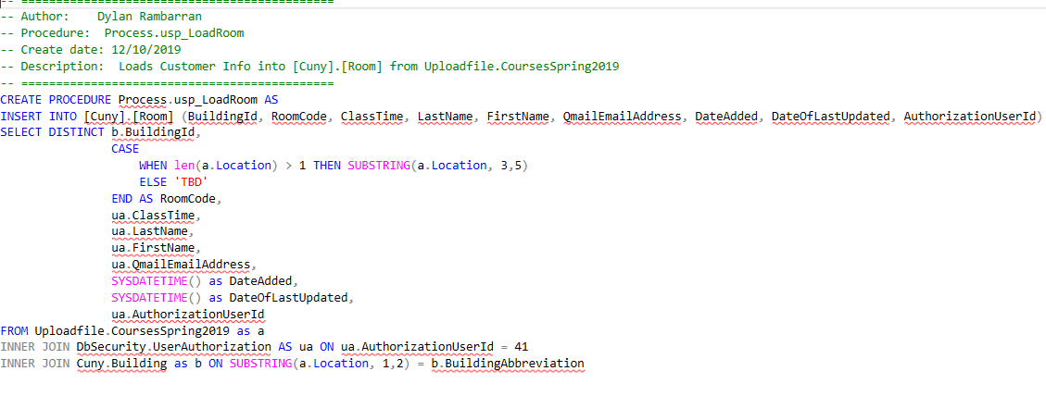
Dylan's Procedures
Process.usp_LoadRoom

Slide 13
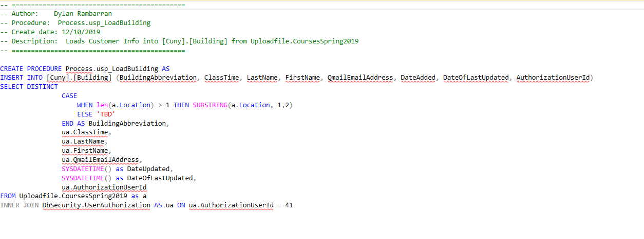
Dylan's Procedures
Process.usp_LoadBuilding

Slide 14
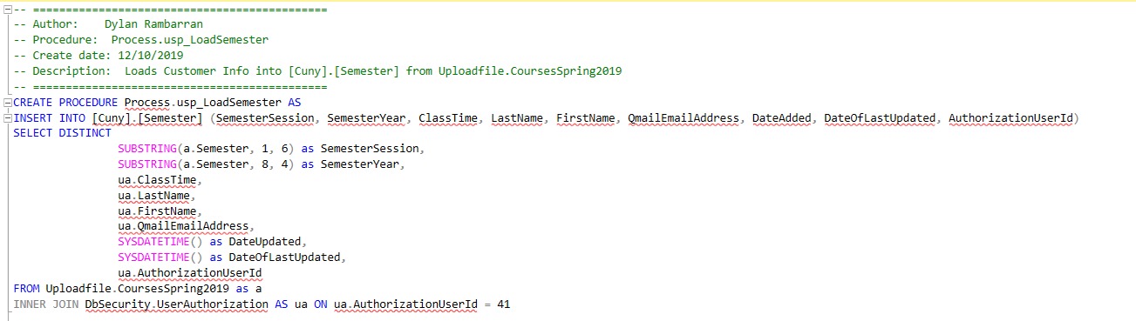
Dylan's Procedures
Process.usp_LoadSemester

Slide 15
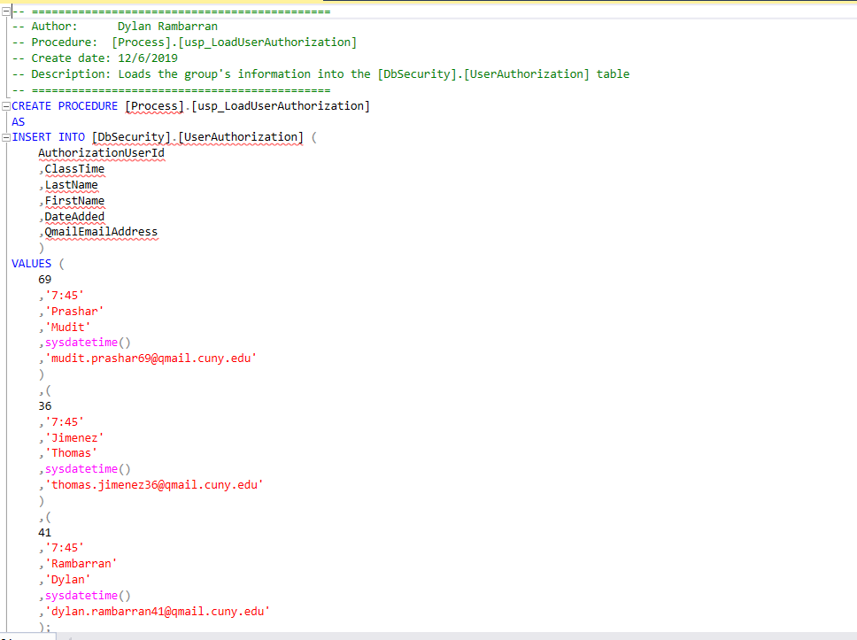
Dylan's Procedures
Process.usp_LoadUserAuthorization

Slide 16
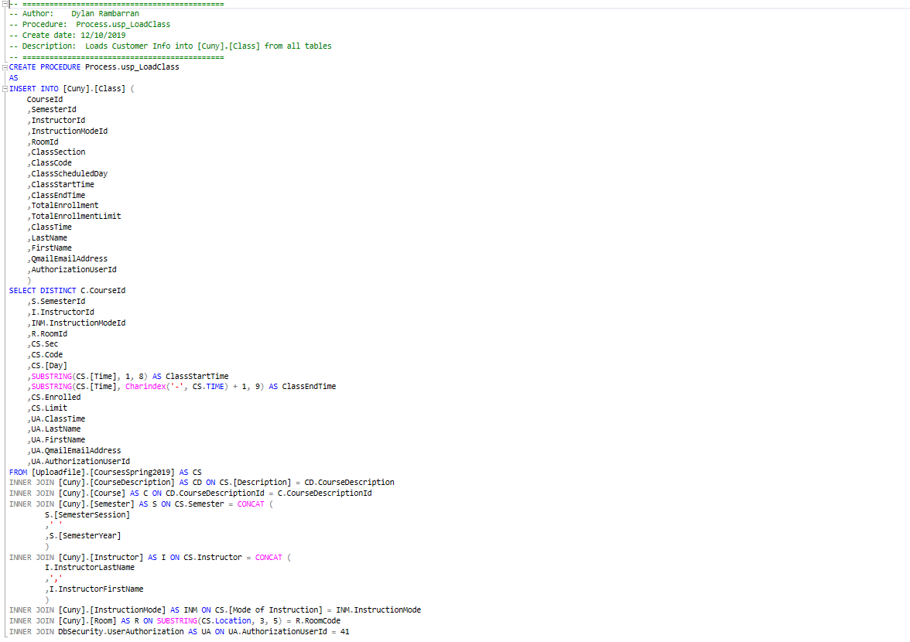
Collaborative Procedure
Process.Class

Slide 17
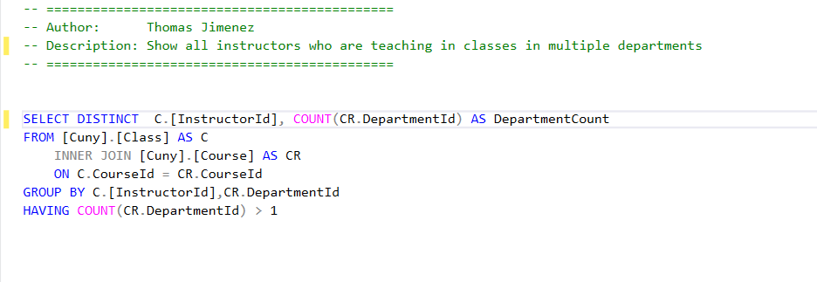
Thomas’s Query 1

Slide 18
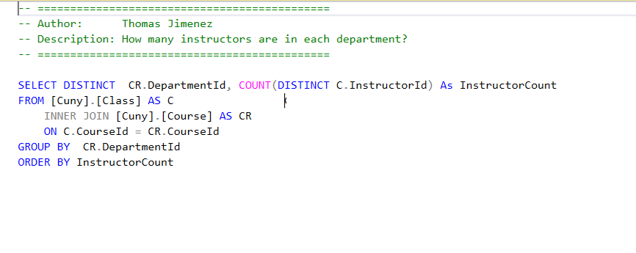
Thomas’s Query 2

Slide 19
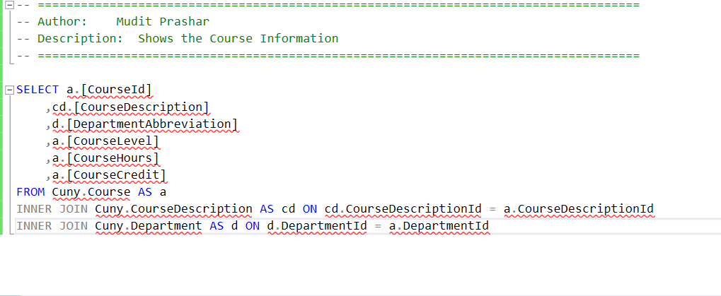
Mudit’s Query 1

Slide 20
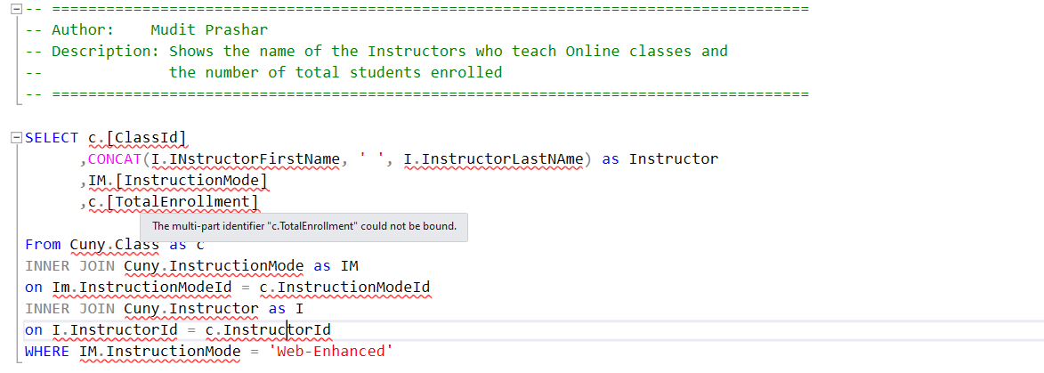
Mudit’s Query 2

Slide 21
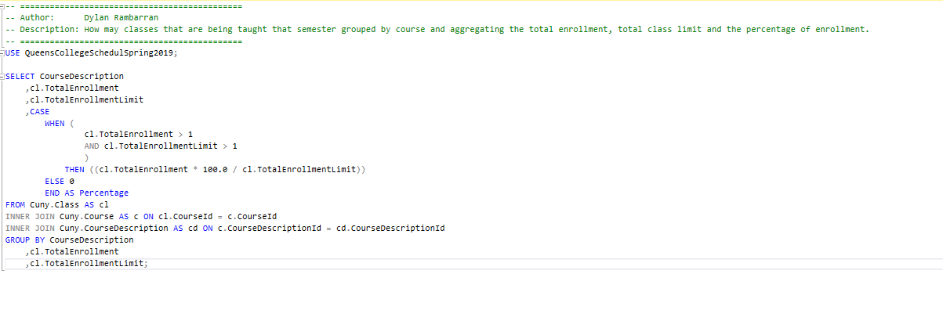
Dylan’s Query 1

Slide 22
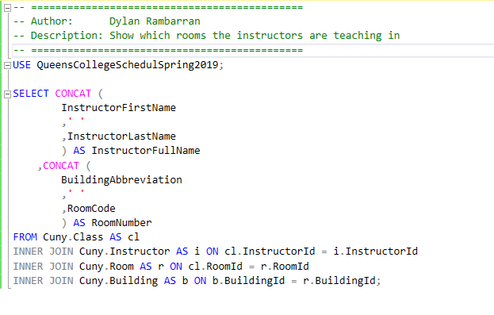
Dylan’s Query 2

Slide 23
Thank you

